Slide 1

Explainable Pneumonia Detection in Chest X-Rays Using ResNet18 and Grad-CAM
Premshainy Kumar Chintapalli AM.SC.P2AML24002
Amrita Vishwa Vidyapeetham
Prof. Sarath S
Amrita School of Computing | Amrita Vishwa Vidyapeetham | Amritapuri

Slide 2
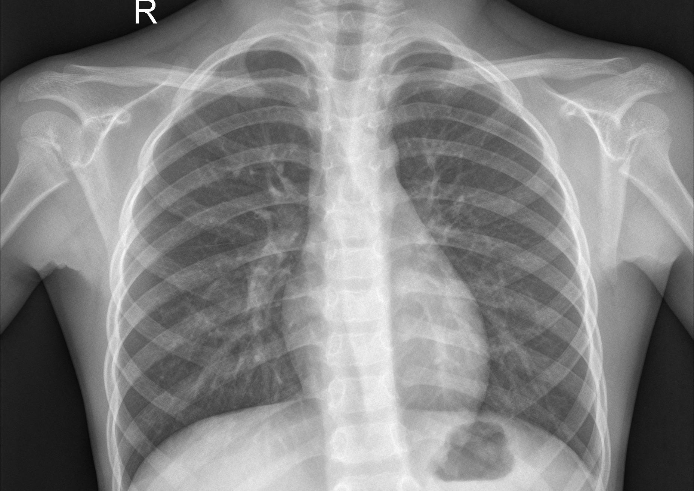
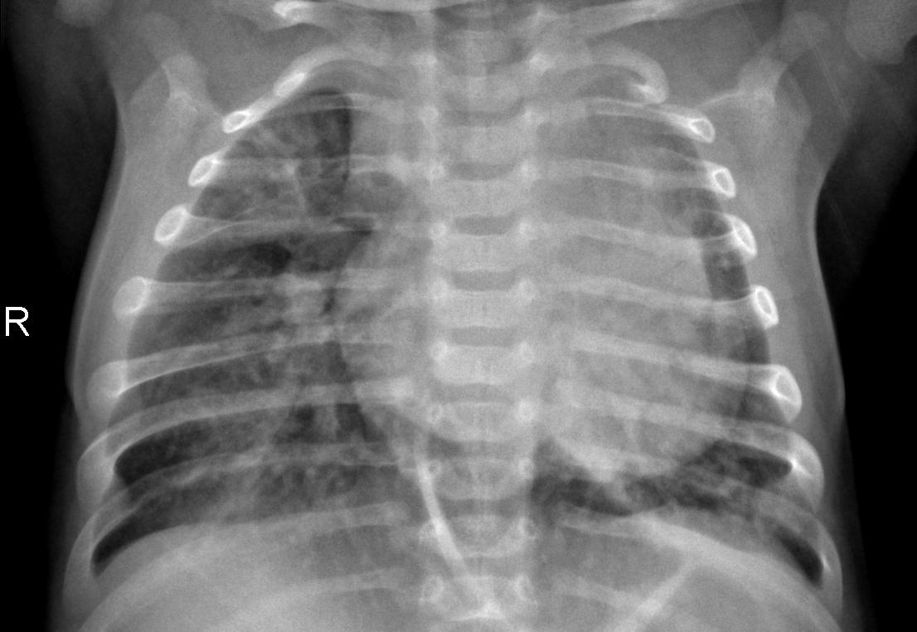
Introduction
This project uses deep learning to detect pneumonia from chest X-ray images. We trained a ResNet18 model to classify images as NORMAL or PNEUMONIA, achieving high accuracy.
To make the model's decisions explainable, we applied Grad-CAM, which highlights the exact lung areas that influenced the prediction. This helps build trust in AI by showing where and why the model made a decision.
The entire solution is wrapped in an easy-to-use Gradio web interface, where users can upload an image and instantly see both the prediction and a heatmap.
Accurate
Interpretable
User-Friendly
Normal
Pneumonia
Our model detects pneumonia from chest X-rays and highlights infected regions using Grad-CAM.

Slide 3
Related Work/Background
Deep Learning in Medical Imaging
CNNs like ResNet, DenseNet, and VGG have shown strong performance in classifying medical images.
Kermany et al. (2018) used CNNs to detect pneumonia from chest X-rays with promising accuracy.
Challenges with Existing Approaches
Most models act as black boxes — clinicians cannot see how decisions are made.
Many solutions lack real-time interfaces and visual interpretability.
Recent Advances
Grad-CAM introduced as a way to make CNN decisions interpretable.
Research is shifting toward explainable AI (XAI) in healthcare.
Our Contribution
Combines ResNet18 for performance with Grad-CAM for transparency.
Deployed via an interactive Gradio UI for real-time usage.

Slide 4
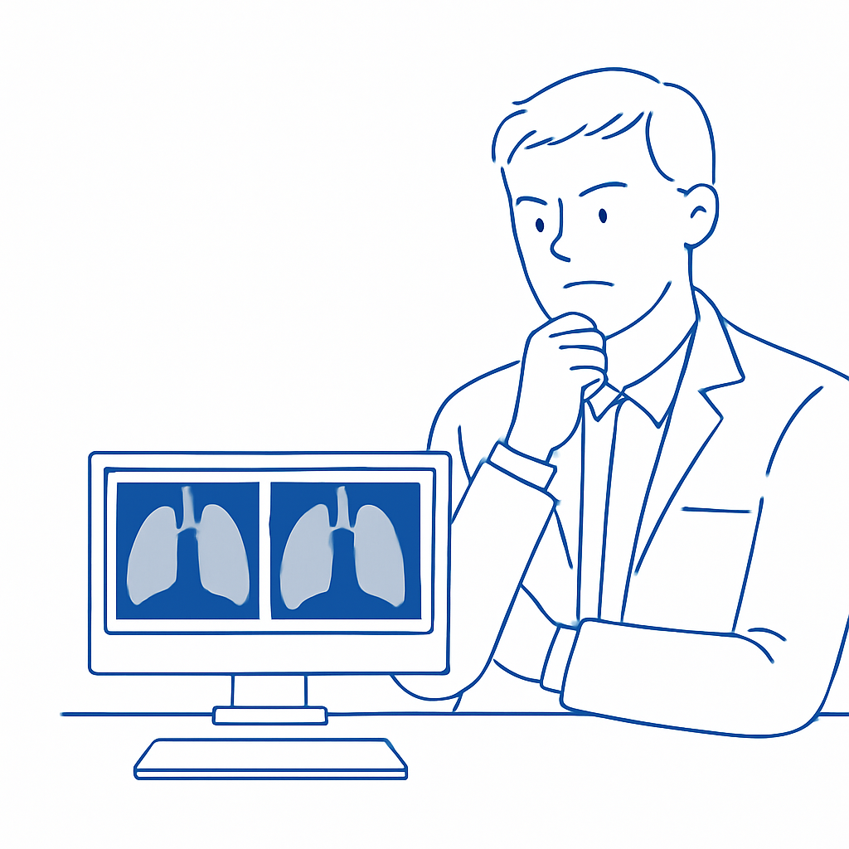
Problem Statement
Problem: Pneumonia is a serious lung infection that can be fatal if not diagnosed and treated early. In many regions, especially rural or under-resourced areas, there is a shortage of expert radiologists to analyze chest X-rays and detect pneumonia accurately.
Challenges:
Manual diagnosis from X-rays is time-consuming and subjective
Existing AI models lack explainability, making them hard to trust in clinical use
There's a need for an automated, accurate, and interpretable solution
Goal:
To develop a deep learning model that can automatically detect pneumonia from chest X-rays and provide visual explanations using Grad-CAM, enabling doctors to understand and trust the predictions.
Emphasizes the burden on human experts

Slide 5
Background
Convolutional Neural Networks (CNNs) like ResNet, DenseNet, and VGG have shown remarkable success in medical image classification, including pneumonia detection from chest X-rays.
A notable work by Kermany et al. (2018) used transfer learning on CNNs to classify chest X-ray images into NORMAL and PNEUMONIA, achieving strong performance.
However, most of these models function as black-box systems, offering no visual explanation of predictions — limiting clinical trust.
Recent Trends:
Introduction of Grad-CAM has enabled visual explanation of CNN outputs by highlighting regions that influenced the decision.
Increasing focus on Explainable AI (XAI) in healthcare to improve transparency, trust, and adoption in real-world scenarios.
Gap We Address:
Existing models focus on accuracy but ignore interpretability. Our project aims to combine ResNet18’s performance with Grad-CAM’s explainability, deployed via a real-time Gradio web interface.

Slide 6
Objective/Contribution
Objective:
To build an AI-powered system that can automatically detect pneumonia in chest X-ray images and provide visual explanations for its predictions, making it suitable for clinical use.
Key Contributions:
Trained a ResNet18 model to classify chest X-rays into NORMAL and PNEUMONIA.
Integrated Grad-CAM to generate visual heatmaps showing which regions influenced the decision.
Built a user-friendly Gradio UI, allowing users to upload X-rays and instantly receive:
Classification result
Grad-CAM visualization
PDF report (optional)
✅ Compared performance with alternative models (like DenseNet) to validate effectiveness.

Slide 7
Model Architecture
Base Model: ResNet18
A Convolutional Neural Network with 18 layers
Pretrained on ImageNet and fine-tuned on chest X-ray images
Modified final fully connected layer to output 2 classes: NORMAL and PNEUMONIA
Input Pipeline:
Input: Chest X-ray Image (Resized to 224×224)
Transforms: Normalize, Tensor Conversion
Output: Class probabilities
Explainability Layer: Grad-CAM
Extracts gradients from the last convolutional layer
Highlights areas in the X-ray that influence the prediction
Generates a heatmap overlay on the original image
Input X-ray Image
↓
Preprocessing
↓
ResNet18 CNN
↓
Final Dense Layer (2 classes)
↓
Prediction + Grad-CAM Heatmap

Slide 8
Proposed Methodology
Data Collection
Chest X-ray dataset from Kaggle
Two classes: NORMAL and PNEUMONIA
Data Preprocessing
Resize to 224×224
Normalize pixel values
Augmentation (if applied)
Model Training
Fine-tune ResNet18 on the training set
Loss Function: Cross Entropy
Optimizer: Adam or SGD
Metrics: Accuracy, Precision, Recall, F1-Score
Explainability Module
Use Grad-CAM to visualize attention
Generate heatmaps over input X-ray images
Helps validate model’s decision-making
User Interface (Gradio)
Upload chest X-ray
View prediction (NORMAL or PNEUMONIA)
View Grad-CAM heatmap
Optional: Generate downloadable PDF report
Data
↓
Preprocessing
↓
ResNet18
↓
Grad-CAM
↓
Gradio Output

Slide 9
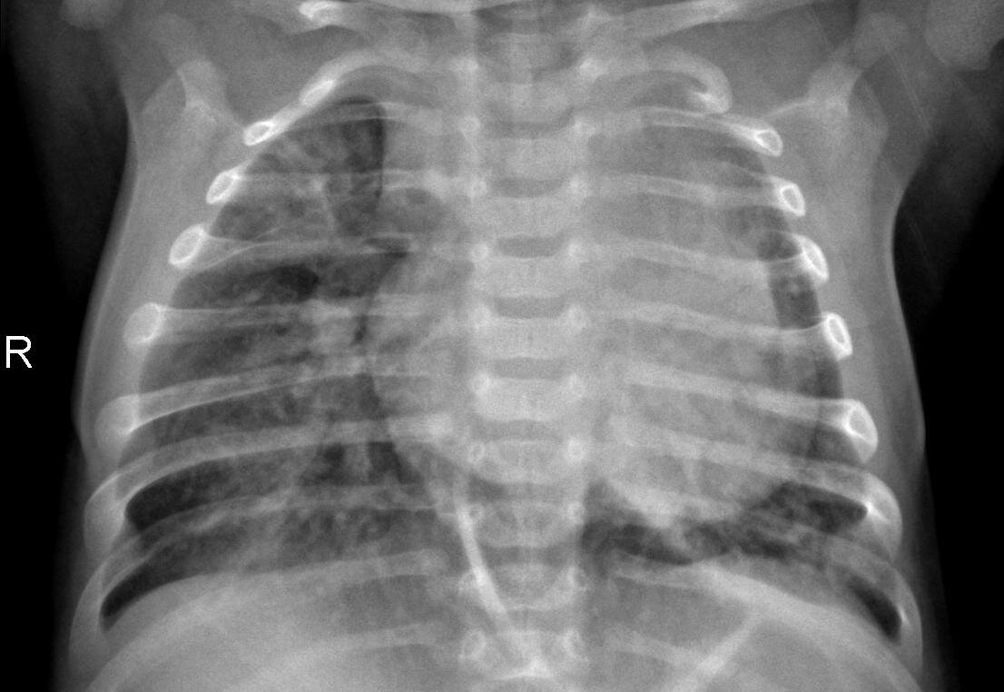
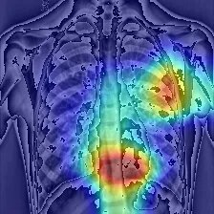
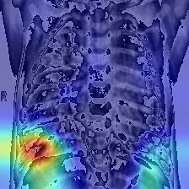
Results & Analysis
Model Performance on Test Data
After training the ResNet18-based model for 10 epochs with data augmentation and transfer learning, the following performance was observed on the test dataset:
Training and Validation curves
The training accuracy and validation accuracy steadily increased and converged without overfitting.
The loss curves decreased smoothly, showing stable learning behavior.
Normal
Pneumonia

Slide 10
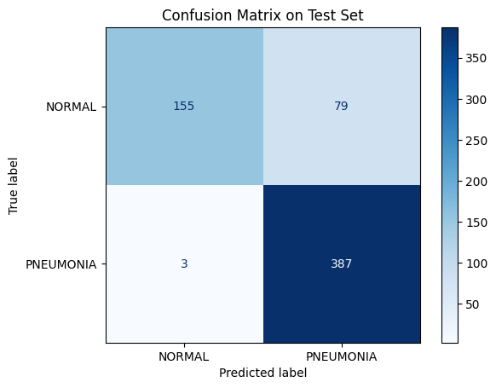
Result and Analysis continution
Confusion Matrix: The confusion Matrix shows
True Positives (TP): Correctly predicted pneumonia cases
True Negatives (TN): Correctly predicted normal cases
False Positives (FP): Normal predicted as pneumonia
False Negatives (FN): Pneumonia predicted as normal
Key Observations:
The model generalizes well to unseen test data.
The use of ResNet18 with transfer learning significantly reduces training time and improves performance.
Misclassifications could be due to:
Poor X-Ray Quality
Early-stage pneumonia signs being subtle
Overlapping features in normal and diseased lungs

Slide 11
Conclusion
Developed a deep learning model using ResNet18 for detecting pneumonia from chest X-ray images.
Integrated Grad-CAM to generate visual explanations, making predictions more interpretable and reliable.
Achieved high accuracy and recall, proving the model generalizes well to unseen test data.
Deployed the system through an easy-to-use Gradio interface, allowing real-time predictions and heatmap visualization.
Key Takeaways
AI can effectively support medical diagnosis when combined with explainability.
Grad-CAM bridges the gap between black-box AI and clinical trust.
Real-time UI tools like Gradio enhance the usability and adoption of AI in healthcare.

Slide 12
THANK YOU
Amrita School of Computing | Amrita Vishwa Vidyapeetham | Amritapuri

